Slide 1
Review for Exam 2

Slide 2
outline
Exam format
How to prepare
Data storage (1 quiz)
Sorting and indexing (2 quiz and 1 homework)
Join operation (1 quiz)

Slide 3
Format
Open book
Timed (3 hours)
Available from Tuesday 9:30 am to Wednesday 9:30 am, ct
Submission link will disappear after deadline! NO LATE submission
Printing is not necessary
PDF submission. (Accept handwriting! Make sure the picture/scan is clear and readable)
Question format: drawing, short answer, long answer, etc.

Slide 4
How to prepare
Read slides
Review questions on notes (do it yourself before checking the answers!)
Review quizzes
Review homework
Prepare a cheat sheet
Write pseudo-code
Ask/answer questions on Piazza. The discussion can strengthen your understanding

Slide 5
Data storage
Concept
How to insert/delete a record from the file

Slide 6
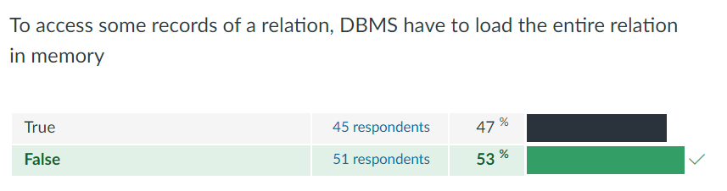
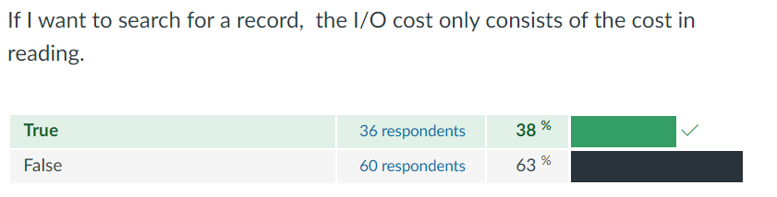
Common problem: Quiz

Slide 7
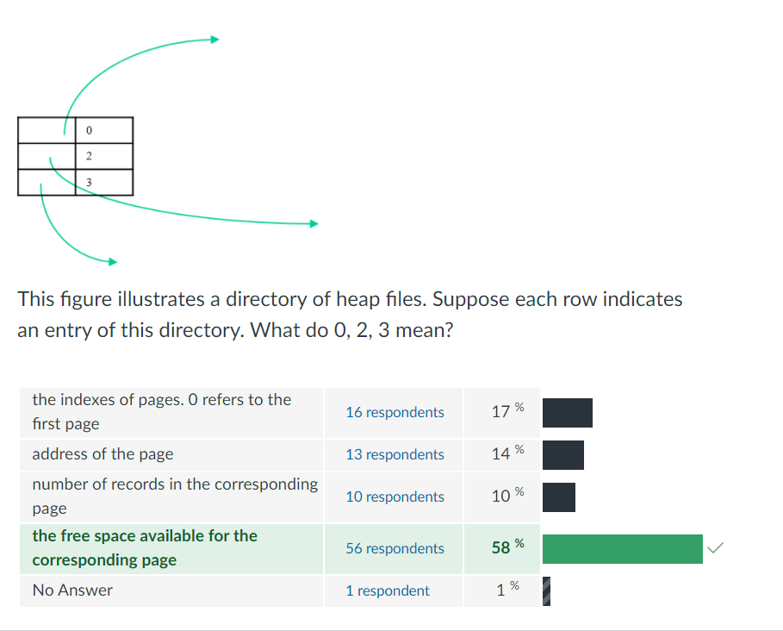
Common problem: Quiz

Slide 8
Sorting and indexing
What is the cost (I/O and space)
What is the benefit
Multi-way merge sort
B+ tree
Hash index
ISAM

Slide 9
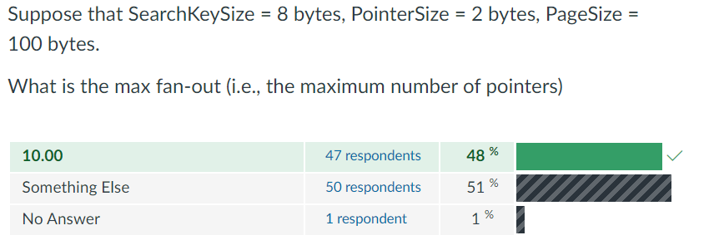
Common problem: Quiz

Slide 10
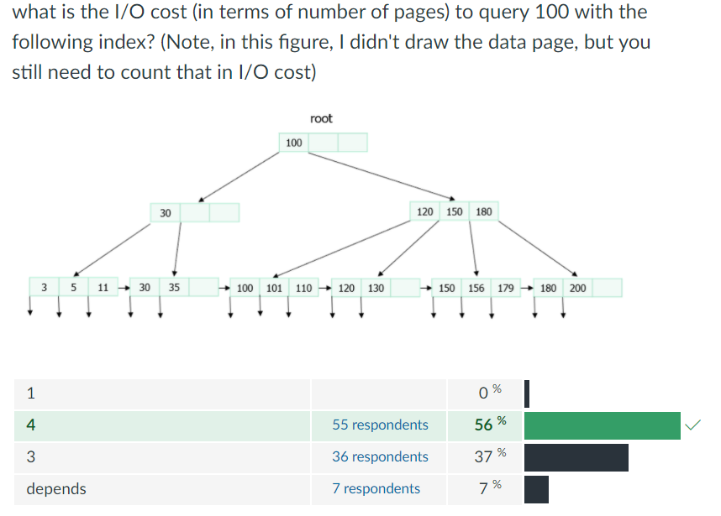
Common problem

Slide 11
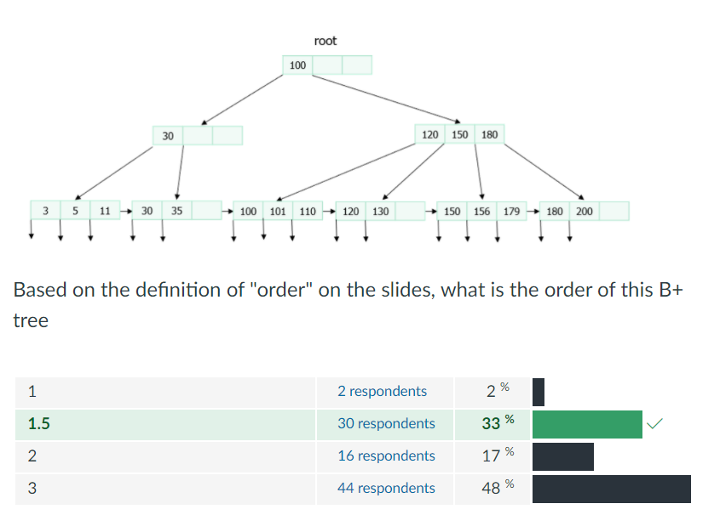
Common problem: Quiz

Slide 12
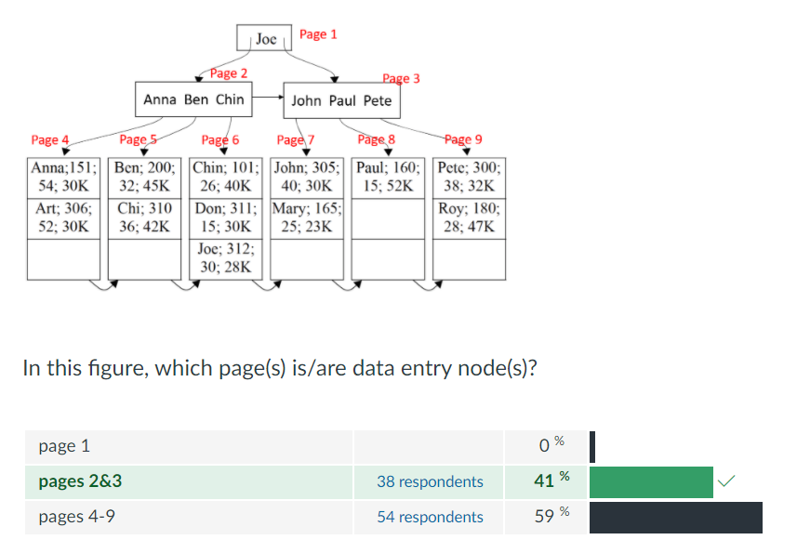
Common problem: Quiz

Slide 13
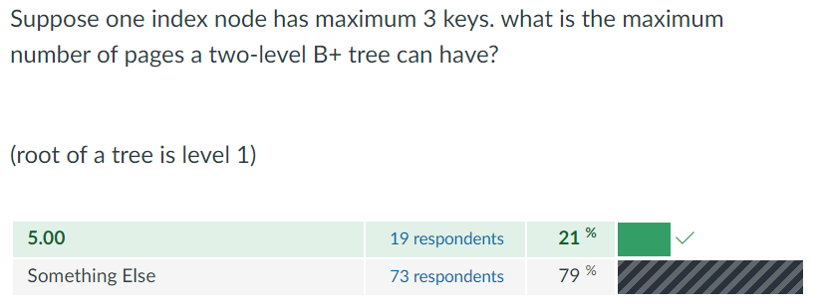
Common problem: Quiz

Slide 14
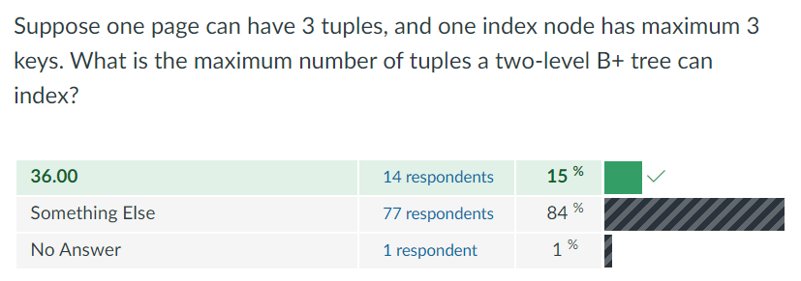
Common problem: Quiz

Slide 15
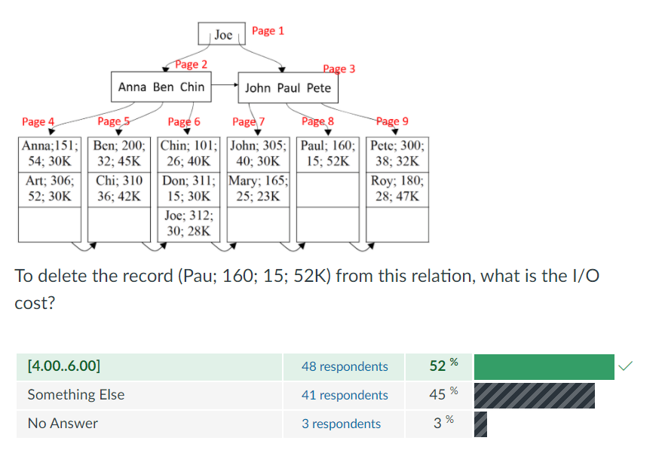
Common problem: Quiz

Slide 16
Common problem
Index nodes
Directory nodes
Data entry nodes
Data pages
What the B+ tree should look like (how many levels)

